Slide 1
Case Conference
Anukruti Rohini
M.Phil. Clinical Psychology Trainee
Year II
Supervised by: Ms Shivani Kirar
(Assistant Professor), Department of Clinical Psychology,
MAN College of Special Education and Psychological Studies, Guna (M.P.)

Slide 2
Demographic Details
NAME: M.D.
AGE: 40 years
Date of Administration: 28/07/2026
SEX: Female
RELIGION: Hindu
EDUCATION: BA in Hindi Literature
OCCUPATION: School Teacher
SOCIOECONOMIC STATUS: Middle SES
MARITAL STATUS: Married
RESIDENCE: Guna
LANGUAGE (Mother Tongue): Hindi
DATE OF BIRTH: 14/06/1986

Slide 3
Demographic Details
INFORMANTS:
Name | Relationship | Duration of Acquaintance
Mr. S.D. | Husband | 15 years
Information provided by the informant is reliable and adequate
Reason for consultation: The patient approached the current mental health institution for a thorough psychological check-up, assessments and for further treatment through individualized counselling/therapy.

Slide 4
Chief Complaints
Chief Complaints:
Difficulty sleeping Irritability Aggression Frequent crying Feeling Unhappy Overthinking Feeling lethargic | 15 years 15 years 15 years 13 years 13 years 13 years 10 years

Slide 5
HOPI
Total Duration: The total duration of illness is 15 years, since 2011.
Onset: The onset of illness is insidious, as the symptoms have developed over the past 15 years.
Course: The course of illness is fluctuating, as symptoms have had changes in intensity over the past 15 years.
Progress: The progress of illness is static.

Slide 6
HOPI
Predisposing Factor: The predisposing factor of illness could not be elicited.
Precipitating Factor: The precipitating factor for developing the illness was a fight with her husband and physical abuse by her husband during that particular fight.
Perpetuating Factor: The perpetuating factor of the illness is stress and pain caused by the fight, as well as poor medical compliance.

Slide 7
History of Present Illness
Index patient M.D. is a 40-year-old married Hindu female educated up to the graduate level, employed as a school teacher, belonging to the middle socio-economic strata, residing in Guna. The patient gradually started experiencing emotional and behavioural changes. The symptoms developed gradually and have been persistent, with fluctuations in their intensity. The patient presented with the chief complaints of difficulty sleeping, irritability, aggression for the past 15 years, frequent crying, not feeling happy for the past 13 years, overthinking and feeling lethargic throughout the day for the past 10 years. The patient reports disturbed sleep, mainly difficulty falling asleep and feeling that sleep is not adequate or refreshing. The patient keeps thinking about different things, especially at night, which makes it difficult to relax and fall asleep. Even after going to bed, the patient continues to think about past and present situations and finds it difficult to stop these thoughts, like: What if my husband is not happy with me because of my illness? I’m not feeling happy or motivated and am not able to keep my family happy. Will I ever get back to normal as before.

Slide 8
History of Present Illness
The patient also reports excessive overthinking. They tend to think repeatedly about different problems and situations and find it difficult to control these thoughts. Minor issues may also occupy her mind for a long time. The patient reports difficulty in concentrating on one thing because the mind remains occupied with multiple thoughts. The patient has become more irritable and short-tempered than before. They report getting annoyed easily, especially when someone questions them, asks them to do something, or when things do not happen according to their expectations. At times, the irritation increases and the patient becomes angry and may speak loudly or argue with family members. The patient feels that they are unable to control their anger easily once it starts. The patient also reports frequent episodes of crying. They may feel like crying without a clear reason or may become emotional when thinking about their problems. The patient describes feeling emotionally low and reports that they do not feel as happy or cheerful as they used to. The patient reports low mood and reduced interest in pleasurable activities. They state that their mind does not feel happy and that they do not enjoy activities in the same way as before. Activities that were previously performed with interest now feel like a burden or require considerable effort. The patient also complains of generalised tiredness and lethargy. They feel that there is weakness or heaviness in the body and that the body feels sluggish. Because of this, the patient finds it difficult to start or complete routine activities and often feels like resting rather than doing work.

Slide 9
History of Present Illness
The patient further reports reduced motivation to work. They do not feel like doing household or other routine activities and have difficulty initiating tasks. Even when they know that a particular task needs to be completed, they may postpone it because they do not feel mentally or physically energetic enough to do it. This has resulted in reduced productivity and difficulty maintaining their usual routine. Poor sleep and excessive thinking contribute to tiredness and irritability, while low mood and reduced motivation further interfere with the patient's daily functioning.

Slide 10
Biological Functioning
Sleep: The patient has experienced disturbance in sleep, specifically inability to fall asleep on time, waking up in the middle of the night.
Appetite: A decline in appetite has been reported over a period of time
Self-care: The patient’s self-care is intact
Bowel and Bladder control: The patient’s bowel and bladder control is intact.
Occupational Functioning: The patient struggles to carry out day-to-day functions consistently due to low motivation and feeling lethargic.

Slide 11
Negative History
There is no history suggestive of any head injury, head trauma followed by periods of unconsciousness, fits like symptoms such as fluttering of mouth, jerky movement, rolling of eyes, and tongue biting or urination.
There is no history suggestive of intake of tobacco, alcohol, cannabinoids, opioids, and excessive intake of caffeine.
There is no history suggestive of hearing voices in the absence of others, talking to self, smiling or crying by self, feeling of doubts or excessive fear towards others.
There is no history suggestive of big talk, feeling excessive happiness, feeling increased energy, reckless spending, increased aggression, and high mood
There is no history suggestive of having a same thought again and again, having to do same thing multiple times, having same image comes to mind again and again, and wasting several hours by doing same act.
There is no history suggestive of increased aggression, increased emotionality and talking certain rule strictly.

Slide 12
Treatment History
Medical History
No significant past medical history
Psychiatric History:
Patient has been on psychiatric medication for the past 15 years, but upon improvement, she stops taking medication during the course.

Slide 13
Family History
Family History of Medical/Psychiatric Disorders: There is a history of medical illness in the patient's family, i.e., diabetes.
Living arrangements: The patient lives in a nuclear family setting
Primary Caregiver: Husband
Communication style: Patient is not able to convey her thoughts and ideas freely with her family members. Although she tries, to but is not able to share all her feelings.
Family’s Understanding of Illness: The patient's family understands the nature of illness and is open to treatment options.
Family Stressors and Discords: No significant family stressors or discords.

Slide 14
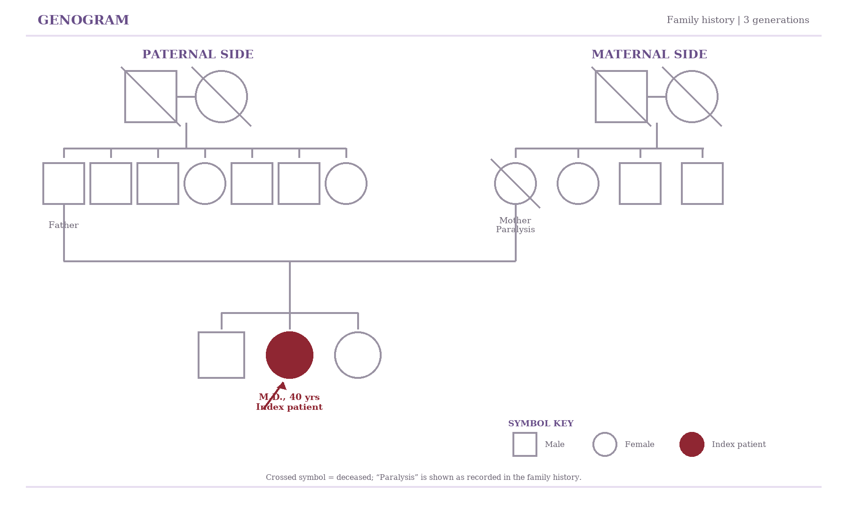
Family History

Slide 15
Personal History
1. Birth and Early Development: The patient was born through normal delivery at a govt hospital; information about the birth cry is missing, as the informant was her husband.
2. Developmental milestones: The patient’s developmental milestones were mostly age-appropriate.
3. Behaviour during childhood: The patient’s behaviour during childhood was characterised by calmness. She was soft-spoken.
4. Physical illness during childhood: No physical illness during childhood.

Slide 16
Personal History
5. Home atmosphere in Childhood and Adolescence: Her home environment during childhood and adolescence was cordial.
6. Scholastic and Extracurricular Activities: She was average in her studies and used to participate in extracurricular activities (Singing) when she was in school.
7. Occupation: Currently, she is a govt school teacher.
8. Menstruation History: As reported by the patient, she obtained her menarche when she was 15 years old. She experiences regular menses without any pain, and the menstrual cycle is normal 3-4 days.

Slide 17
Personal History
9. Sexual History: As reported by the patient, she engages in sexual activity 3-4 times a month, which is satisfactory and uses protection during intercourse.
10. Marital History: The patient has been married for the past 15 years, through an arranged marriage, and has two children.
11. Substance Use: As reported by the patient and her family, there is no history of consuming tobacco, alcohol, opioids, cannabis, brown sugar, or cocaine.
12. Forensic History: As reported by the patient, there is no legal or forensic history.

Slide 18
Premorbid Personality
The patient’s premorbid social relationships were cordial and interactive. She used to initiate conversations and maintain contact with her relatives and friends, and shared a good relationship with her family members. She was responsible towards her work and household duties and was actively involved in managing the family and caring for her children and husband. Her energy and initiative were appropriate, and she was able to initiate and complete daily tasks and make plans for her family. Her premorbid mood was generally cheerful and contented, although she would become upset easily. When faced with stressful situations, she tended to respond in an emotion-oriented manner, often through crying, verbal arguments, or refusing to communicate with others. In her free time, she enjoyed watching movies and listening to music.
She generally had a positive attitude towards herself and high self-esteem. She believes and maintains moral and religious standards. She also considered maintaining her health and fitness important.

Slide 19
Mental Status Examination (MSE)
GENERAL APPEARANCE AND BEHAVIOUR
The patient appeared well-kempt, with personal hygiene appropriately maintained. She entered the room voluntarily and was cooperative towards the examiner throughout the session. Her facial expressions and body language indicated that he had an interest in the interview, and she maintained consistent eye contact; rapport was established with ease. Although her overall behaviour was cooperative, she was observed to be slightly anxious during the interaction.

Slide 20
Mental Status Examination (MSE)
PSYCHOMOTOR ACTIVITY
SPEECH
Coherence: Patient was able to comprehend and understand, and her speech was relevant
Relevance: Responses were relevant to the questions asked
Tone: The tone of the speech was low
Tempo: The tempo of the speech was within the appropriate range.
Reaction time: The Reaction time of the speech was appropriate
Volume: The volume of the speech was low

Slide 21
Mental Status Examination (MSE)
PSYCHOMOTOR ACTIVITY
THOUGHT
Form: There is no disorder in the form of thought
Stream: There is no disorder in the stream of thought
Possession: There is no disorder in the possession of thought
Content: Her thought content revealed depressive cognitions, mostly unhappiness, reduced energy and frequent crying about her feelings and hopelessness about getting better in the future.

Slide 22
Mental Status Examination (MSE)
Mood and affect
Mood: “Man khush nahi hai bilkul."
The patient's subjective mood was dysthymic.
Affect: The patient’s objective mood was congruent.
Sensorium and perception:
No perceptual disturbances were present

Slide 23
Mental Status Examination (MSE)
HIGHER COGNITIVE FUNCTIONS
Levels of Consciousness: The patient was drowsy
Orientation: To assess orientation to time, the patient was asked, "Abhi kya time ho raha hai?" (Time 5:30 ho raha hai). Then she was asked, "Aap aaj jis jagah par aye hain, ye konsi jagah hai, iska kya naam hai?" (place) (Man Haspatal hai ye.”). Lastly, she was asked, "Apke sath yahan kon aya hai?" (Person). She answered, “pati”
Impression: The patient was oriented to time, place and person.
Attention and Concentration: Her attention was aroused and sustained. She was able to complete the digit span forward and backwards up to 4 digits
Serial subtractions test: She was able to complete serial subtraction (20-1) within 15 seconds.

Slide 24
Mental Status Examination (MSE)
MEMORY
Immediate: She was able to correctly recall all three words out of three words given to her, which were Aam, kursi and sui.
Recent: In recent memory tasks, the patient was able to recall what she had for breakfast and how she travelled to the hospital a few hours ago.
Remote: The patient was able to recall the date of her birth and her school’s name and confirmed with the informant
Impression: Immediate, recent and remote memory seem to be intact and normal.

Slide 25
Mental Status Examination (MSE)
ABSTRACTABILITY
Differences: Aloo vs Patthar
(Aloo – “sabji hai, khate hai, Pathar – kadak hai, pakta nahi.”)
Similarities: santra vs nimbu
(santra aur nimbu– kali hoti hai, beejh hota hai.”)
Proverbs: When asked with a proverb “Jaisi karni waisi bharni, she answered, “ jaisa karoge waisa bharoge”
Impression: Abstractability is intact on functional level

Slide 26
Mental Status Examination (MSE)
INTELLIGENCE
General information: To assess general awareness, the patient was asked about the three rivers of India. She was then asked to tell about the President of India. She was able to answer all the questions
Comprehension: Patient was able to comprehend and carry out the sequential task assigned to her.
Arithmetic and Calculations: 500-350 =150. The patient could correctly answer the question.
Impression: The patient’s intelligence is above average.

Slide 27
Mental Status Examination (MSE)
JUDGEMENT
On enquiring about her personal and future views, for example, what she would like to do once she leaves here, she answered that she will go straight home and do the chores. For the future, she plans to continue her job and get a promotion. Further on the list of judgements on a test is finding a random envelope on the road, and if any building catches fire, what she will do is answer by saying she would not pick up a stranger's letter; it may have dangerous material in it. For fire, she replied, 'Call the fire brigade and help the family.' Likewise, when asked about her reaction to witnessing an accident, she replied that she would help them and would call the ambulance. Thus, the patient's personal judgement was intact.

Slide 28
Mental Status Examination (MSE)
INSIGHT LEVEL
Insight Grade Level:
Q. Kya apko lagta hai ki apko kuch bimari hai? Kis prakar ki bimari h aur yeh kaise theek hoga?
A. "Mujhe toh lagta hai ki mere andar kuch kharab hai aur use thik hone mei time lag raha hai."
Impression: The patient has an insight level of Grade IV, awareness of being sick due to something unknown in self.

Slide 29
TESTS ADMINISTERED
Beck Depression Inventory (BDI-II)
The patient has obtained a score of 34 on the Beck Depression Inventory (BDI-II) falls within the Severe depression range.
The patient obtained a BDI-II score of 34, which falls in the severe range of depressive symptoms. This is consistent with her reported low mood, frequent crying spells, reduced happiness and interest in pleasurable activities, low motivation, lethargy, difficulty concentrating, and disturbed sleep. She also reports difficulty initiating and completing routine activities, resulting in reduced productivity.

Slide 30
TESTS ADMINISTERED
Beck Anxiety Inventory (BAI)
The patient has obtained a score of 23 on the Beck Anxiety Inventory (BAI) falls within the Moderate Anxiety range.
The patient obtained a BAI score of 23, which falls in the moderate range of anxiety symptoms. This is consistent with her reported excessive and repetitive overthinking, difficulty controlling thoughts, difficulty relaxing, disturbed sleep due to persistent thinking, difficulty concentrating, irritability, and increased emotional distress. The ongoing stress related to marital conflict and physical abuse may further contribute to her anxiety symptoms.

Slide 31
Overall Interpretation
Overall, the psychological assessment indicates clinically significant depressive symptomatology accompanied by moderate anxiety symptoms. The BDI-II score of 34 falls within the severe range of depressive symptoms, including persistent low mood, frequent crying spells, reduced happiness and interest in pleasurable activities, lethargy, decreased motivation, poor productivity, and difficulty concentrating. The BAI score of 23 falls within the moderate range of anxiety, which is consistent with excessive and repetitive overthinking, difficulty controlling thoughts, difficulty relaxing, disturbed sleep, irritability, and concentration difficulties. The patient's symptoms have been persistent for approximately 15 years, with fluctuations in intensity, and have resulted in impairment in routine functioning. The combination of prolonged depressive symptoms, reduced interest and motivation, fatigue, sleep disturbance, and associated anxiety suggests a chronic depressive condition with prominent anxious features.

Slide 32
DIAGNOSTIC FORMULATION
Index patient M.D, a 40-year-old female from Guna, currently a school teacher, educated up to BA in Hindi Literature, married, and coming from a middle socioeconomic strata. The patient presented with the chief complaints of difficulty sleeping, irritability, aggression for the past 15 years, frequent crying, not feeling happy for the past 13 years, overthinking and feeling lethargic throughout the day for the past 10 years. The illness appears to have an insidious onset and a continuous course. The onset of symptoms was precipitated by a fight with her husband and physical abuse and perpetuated by stress caused by fight with her husband and poor medical compliance. MSE findings revealed intact cognitive functions, dysphoric mood, depressive thought content, and Grade IV insight.

Slide 33
PROVISIONAL DIAGNOSIS
The patient's clinical presentation is most consistent with F34.1 Dysthymia (Persistent depressive disorder).
Differential Diagnosis: F32.2 Severe Depressive Episode without psychotic symptoms
POINTS IN FAVOUR
Persistent low mood: Patient reports feeling sad for the past 10 months, indicating sustained depressive affect.
Insidious onset: Symptoms developed gradually, which is consistent with the chronic nature of dysthymic presentations.
Continuous course: The illness has followed a continuous course, suggesting persistence rather than distinct episodic depressive episodes.
Dysphoric mood: MSE revealed a dysphoric mood, corroborating the patient's subjective report of sadness.
Ruminative thinking: The patient reports excessive overthinking and worry for the past 4 years, with MSE showing ruminative thought content, indicating persistent cognitive preoccupation.
Difficulty relaxing with preserved cognition: The patient experiences difficulty resting/relaxing, while cognitive functions remain intact, consistent with a chronic depressive-anxious presentation without marked cognitive impairment.

Slide 34
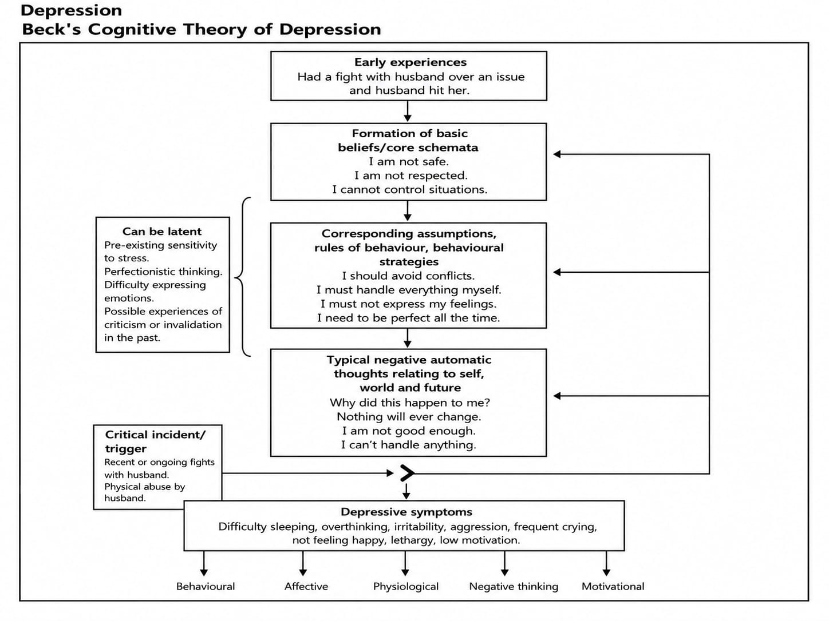

Slide 35
Rationale for Therapy
Cognitive Behaviour Therapy for Depression
CBT for depression is appropriate because the patient presents with low mood, reduced interest, crying spells, low motivation, lethargy, disturbed sleep, irritability, excessive thinking and impairment in daily functioning.
Understand the cycle between low mood, inactivity and negative thinking.
Identify and modify negative automatic thoughts.
Increase activity and positive reinforcement through behavioural activation.
Address hopelessness, guilt, helplessness and negative predictions about the future.
Develop problem-solving, coping and sleep-management skills.
Maintain progress and prevent future relapse.
The therapy will remain collaborative, structured and gradual. Risk, sleep, mood and daily functioning should continue to be monitored throughout treatment.

Slide 36
Goals for Therapy
Short-Term Goals
Establish rapport and a collaborative therapeutic relationship.
Provide psychoeducation about depression and the CBT model.
Identify the relationship between thoughts, emotions, behaviour and physical symptoms.
Increase daily routine and participation in pleasurable activities.
Identify negative automatic thoughts and cognitive distortions.
Begin reducing excessive thinking, withdrawal and inactivity.
Improve sleep routine and activity planning.

Slide 37
Goals for Therapy
Long-Term Goals
Reduce depressive symptoms, including low mood, crying spells, irritability and lethargy.
Improve sleep, motivation and daily functioning.
Increase engagement in household, occupational and pleasurable activities.
Develop more balanced thinking and adaptive coping strategies.
Improve problem-solving and emotional regulation.
Prevent relapse and support independent use of CBT skills.

Slide 38
Initial Phase (Session 1-5)
Session 1 — Rapport Building and Initial Assessment
Session Goals
Establish therapeutic rapport and a safe, non-judgemental environment.
Understand the patient’s main concerns in her own words.
Explore the effect of low mood, poor sleep, overthinking and low motivation on daily life.
Identify the patient’s expectations and collaboratively set initial therapy goals.
Intervention
The patient was encouraged to describe her emotional and behavioural difficulties, including frequent crying, reduced happiness, lethargy, irritability, excessive thinking and difficulty completing routine activities. The therapist validated her distress and explored the relationship between symptoms and daily functioning.
Homework
Observe mood changes during the week.
Note situations associated with low mood, irritability or excessive thinking.

Slide 39
Initial Phase (Session 1-5)
Session 2 — Psychoeducation and Introduction to the CBT Model
Session Goals
Provide psychoeducation about depression.
Introduce the CBT model.
Help the patient understand how thoughts, emotions, physical sensations and behaviour are connected.
Intervention
The patient was introduced to the depressive cycle:
Low mood → reduced activity → fewer positive experiences → increased negative thoughts → further low mood
The therapist explained that reduced activity and withdrawal can maintain depression, while gradual engagement in meaningful activities can support improvement.
Homework
Record situations, thoughts, emotions and behaviours using a simple CBT monitoring format.
Observe how inactivity affects mood.

Slide 40
Initial Phase (Session 1-5)
Session 3 — Behavioural Activation
Session Goals
Identify activities that have reduced or stopped.
Understand the relationship between inactivity and low mood.
Begin planning small and manageable activities.
Intervention
Behavioural activation was introduced. The patient identified routine, household and pleasurable activities that had become difficult because of lethargy, low motivation and low mood. Activities were divided into small steps based on feasibility rather than waiting for motivation to return.
The distinction between pleasure and mastery activities was explained.
Homework
Complete one planned routine activity.
Complete one small pleasurable or mastery-based activity.
Record the effect of the activity on mood and energy.

Slide 41
Initial Phase (Session 1-5)
Session 4 — Behavioural Activation and Activity Scheduling
Session Goals
Review activity completion and difficulties.
Identify barriers to starting or completing tasks.
Strengthen daily structure and routine.
Intervention
The patient’s activity record was reviewed. Avoidance, postponement and low energy were discussed as factors that may maintain depressive symptoms. A graded activity schedule was prepared, including manageable household, self-care and personally meaningful activities.
Sleep-related habits and the effect of excessive thinking at night were also explored.
Homework
Follow the activity schedule.
Practise starting tasks for a limited period rather than waiting to feel motivated.
Maintain a regular sleep and wake time as far as possible.

Slide 42
Initial Phase (Session 1-5)
Session 5 — Introduction to Cognitive Restructuring
Session Goals
Identify negative automatic thoughts.
Recognise common cognitive distortions.
Begin examining the accuracy and helpfulness of negative thoughts.
Intervention
Initial cognitive restructuring was introduced. Thoughts related to hopelessness, failure, helplessness, the future and inability to cope were identified. The patient was encouraged to examine:
What was the situation?
What thought came to mind?
What emotion followed?

Slide 43
Intervention
What evidence does not support it?
What would be a more balanced response?
The therapist explained that thoughts can feel convincing without always being complete or accurate.
Homework
Complete a brief thought record.
Identify one alternative, balanced thought for a distressing situation.

Slide 44
Note
The patient has completed 5 sessions of therapy so far. The subsequent sessions have been planned as a temporary proposed structure for the upcoming weeks.

Slide 45
Middle Phase (Session 6-8)
Focus:
Sessions 6–8 — Continuing Behavioural Activation and Cognitive Restructuring
Proposed Future Sessions
Focus
Strengthen behavioural activation.
Reduce avoidance and withdrawal.
Continue identifying negative automatic thoughts.
Address hopelessness, guilt, helplessness and negative predictions.

Slide 46
Middle Phase (Session 6-8)
Proposed Interventions
Review activity schedules and gradually increase routine, pleasurable and mastery activities.
Identify barriers such as tiredness, low motivation and excessive thinking.
Examine thoughts such as:
“Nothing will improve.”
“I cannot manage my responsibilities.”
“There is no point in trying.”
“I will always feel this way.”
Use evidence examination and generation of balanced alternative thoughts.
Continue monitoring sleep, mood, activity and energy levels.
Introduce simple coping strategies for periods of increased irritability.

Slide 47
Middle Phase (Session 6-8)
Homework
Continue activity scheduling.
Complete thought records for two distressing situations.
Practise one balanced response each day.

Slide 48
Middle Phase (Session 9-11)
Sessions 9–11 — Rumination, Problem-Solving and Functional Improvement
Proposed Future Sessions
Focus
Reduce excessive thinking and repetitive negative thinking.
Improve problem-solving and daily organisation.
Address irritability and emotional reactions.
Improve occupational, household and interpersonal functioning.

Slide 49
Middle Phase (Session 9-11)
Proposed Interventions
Identify triggers and patterns of rumination, particularly during the night.
Introduce scheduled worry or thinking time to reduce repetitive thinking throughout the day.
Practise attention shifting, grounding and engagement in present activities.
Use structured problem-solving for household, work and routine difficulties.
Break large tasks into smaller, achievable steps.
Identify links between poor sleep, tiredness and irritability.
Develop communication strategies for expressing needs without shouting, arguing or withdrawing.
Continue cognitive restructuring of self-critical and hopeless thoughts.

Slide 50
Middle Phase (Session 9-11)
Homework
Practice scheduled thinking time or attention-shifting strategies.
Apply the problem-solving steps to one current difficulty.
Continue planned activities and sleep monitoring

Slide 51
Middle Phase (Session 12-14)
Sessions 12–14 — Consolidation and Preparation for Relapse Prevention
Proposed Future Sessions
Focus
Consolidate behavioural activation and cognitive restructuring.
Strengthen independent coping.
Review progress and remaining difficulties.
Prepare for future stressors and mood fluctuations.

Slide 52
Middle Phase (Session 12-14)
Proposed Interventions
Review the patient’s progress in mood, sleep, motivation, activity and functioning.
Identify the most helpful CBT strategies.
Practise using the CBT model independently.
Develop coping cards or written reminders for common negative thoughts.
Identify early warning signs such as:
Increased crying
Reduced activity
Sleep disturbance
Increased irritability
Excessive overthinking
Loss of interest
Reduced motivation
Prepare alternative responses for each warning sign.
Discuss how to seek support when symptoms increase.

Slide 53
Middle Phase (Session 12-14)
Homework
Prepare a personal list of helpful coping strategies.
Practice responding to early warning signs using the CBT model.
Continue meaningful activities despite fluctuations in mood.

Slide 54
Termination Phase (Session 15-16)
Sessions 15–16 — Relapse Prevention and Termination
Proposed Future Sessions
Focus
Review and consolidate treatment gains.
Develop a relapse-prevention plan.
Support independent use of CBT skills.
Prepare for the end of regular therapy.

Slide 55
Termination Phase (Session 15-16)
Proposed Interventions
Review the original therapy goals and changes achieved.
Consolidate behavioural activation, cognitive restructuring, problem-solving and rumination-management skills.
Develop a written relapse-prevention plan.
Identify situations that may increase the risk of depressive symptoms returning.
Prepare a step-by-step plan for responding to future difficulties.
Discuss continuation of routine, pleasurable and mastery activities.
Review when further professional help may be required.
Gradually prepare the patient for independent management after termination.
Conduct a final review of progress, remaining concerns and future goals.

Slide 56
Termination Phase (Session 15-16)
Final Homework / Maintenance Plan
Continue regular activity scheduling.
Use thought records when negative thinking increases.
Maintain sleep and daily routine.
Review the relapse-prevention plan periodically.
Seek professional support if symptoms significantly worsen or functioning declines.

Slide 57
Note for the PPT
The patient has completed five therapy sessions. Sessions 6–16 represent a tentative future treatment plan and may be modified according to clinical progress, ongoing assessment, risk, treatment response and emerging needs.

Slide 58
THANK YOU!

